Slide 1


ESP32 Based Smart Water Control System
Project Managers:
Ahmed Bera Ekimci
Date :
22.05.2024

Slide 2


ESP32 Based Smart Water Control System
The efficient use and management of water resources are of critical importance today. This project presents a smart water monitoring system developed using the ESP32 microcontroller.

Slide 3


Introduction
This presentation will cover the details of the ESP32-based smart water control system. It will examine key components such as system requirements, IoT technology, ESP32 microcontroller, sensors, control systems, and the Blynk application.
Objective
The aim of this project is to ensure the efficient and sustainable use of water resources and to prevent water waste. By monitoring and optimizing water use, the goal is to reduce unnecessary water consumption and conserve water resources, enhancing environmental sustainability.

Slide 4
Requirements of the Smart Water Control System
Ease of Use:
Energy Efficiency:
The system should be user-friendly. The user experience should be at the highest level.
The system should save water by minimizing energy consumption.
Remote Access:
Safety and Durability:
Users should be able to control and monitor the system from a certain location.
The system should be secure and durable, providing safe solutions against water leaks and malfunctions.

Slide 5

What is IoT (Internet of Things)?
IoT (Internet of Things) is a technological approach that allows devices used in our daily lives to connect and share data with each other via the internet. IoT solutions are used in many fields such as smart homes, cities, factories, agricultural applications, health, and transportation.

Slide 6
Materials Used
ESP32 Microcontroller
Relay Module
YFS-201 Water Flow Sensor
Solenoid Valve
Jumper Cables
Hose
Funnel
Teflon Tape
Electrical Tape
Graduated
Cylinder
Adapter
Pneumatic Fitting
Coupling Part
Project Box
Solder
2 Micro USB Cables

Slide 7
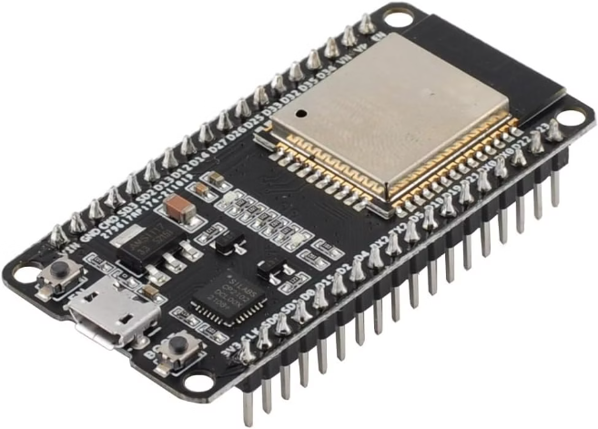
ESP32 Microcontroller
ESP32 is a powerful and flexible microcontroller developed for IoT applications. It stands out with its built-in Wi-Fi and Bluetooth capabilities, efficient performance, and multi-core architecture.
In the water control system, ESP32 acts as the main controller. It processes data from sensors, controls actuators such as relays and solenoid valves, and integrates the entire system with the Blynk application.

Slide 8
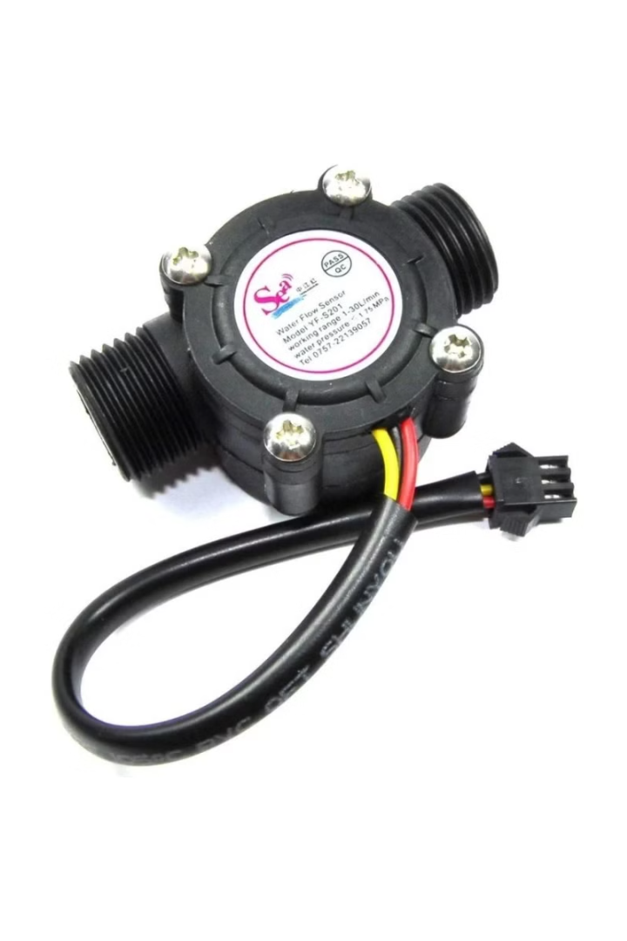
Water Flow Sensors
Water flow sensors are critical components that play a key role in the smart water control system. These sensors measure the water flow in the system and provide real-time water consumption data.

Slide 9
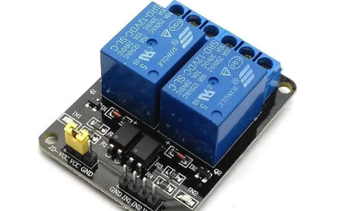
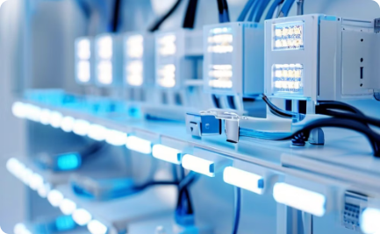
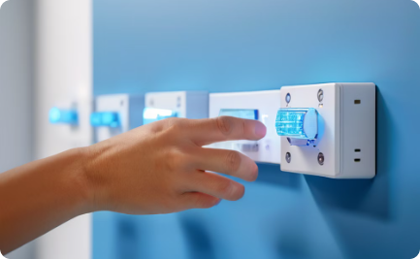
Control with Relay Module
Relay Module
Relay Connections
Relay Control
Allows us to control electrical devices safely. These modules provide electromechanical switching functions to manage critical components in the system.
The input and output terminals of the relay module can be easily connected to other components in the system. This allows us to control solenoid valves or other actuators.
The switches on the relay module are used to perform operations such as opening and closing water. In the smart water control system, this relay module plays a critical role.

Slide 10
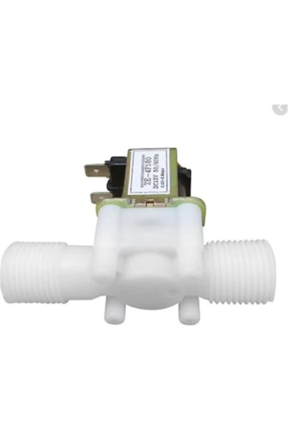
Solenoid Valves
Solenoid valves are a critical part of the water control system. These valves, which open and close with electrical signals, control the water flow.
Solenoid valves enable safe and precise water distribution. In the smart water control system, they are used as main and auxiliary valves, allowing for water flow management.

Slide 11

Energy Management
ESP32 Microcontroller: Nominal operating voltage and current requirements of ESP32 (3.3V 500mA).
Relay Module: Voltage and current values required for the relay module to operate (5V 70mA for each relay).
YFS-201 Water Flow Sensor: Operating voltage: 5V, Operating current: 10mA (maximum).
Solenoid Valve: Operating voltage: 12V DC or 24V DC (depending on the model), Operating current: 500mA - 1A (depending on the model).

Slide 12
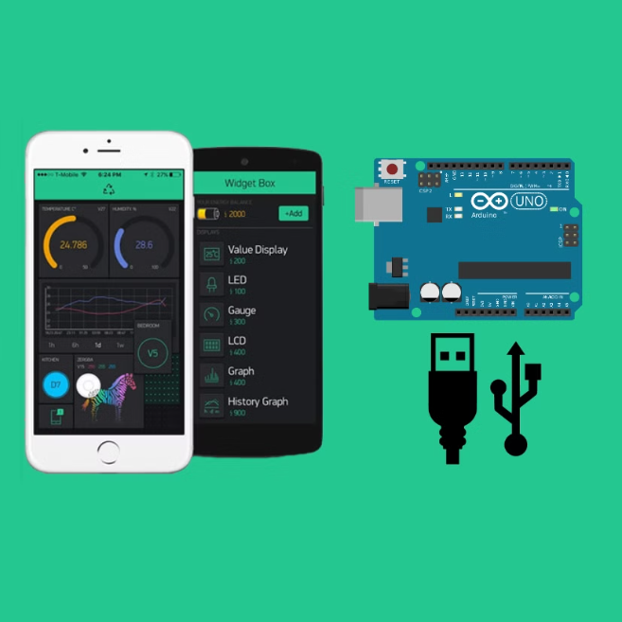
Control with Blynk Application
Blynk application is a powerful platform that you can use to control and monitor IoT projects through smart devices. This section details how to manage your smart water control system with the Blynk application.

Slide 13
Installation of Blynk Application
Downloading the Application: The Blynk application is available for Android and iOS devices. You can download and install the app from Google Play Store or Apple App Store.
Registration and Login: If you are using it for the first time, you need to create an account. If you have an existing account, you can log in with your username and password.

Slide 14
Creating a Blynk Project
New Project Creation: Create a new project in the Blynk application and configure the project settings.
Project Name: Smart Water Control System.
Hardware Selection: ESP32 (or the hardware you are using).
Auth Token: The session key (Auth Token) created by Blynk is sent via email. This key ensures the connection of your project with the hardware.

Slide 15
Configuration of Blynk Widgets
Button Widget: Add a button to open and close the solenoid valve.
Pin: The pin connected to the relay on the ESP32.
Gauge Widget: A measuring device to display data from the YFS-201 water flow sensor.
Pin: The pin reading data from the water flow sensor.
Label: To monitor the current water flow.

Slide 16
Connecting with the Application: Make sure the ESP32 is connected to the internet. Open the Blynk application and check if your project is working.
Using the Blynk Application
Uygulama ile Bağlantı: ESP32'nin internete bağlı olduğundan emin olun. Blynk uygulamasını açın ve projenizin çalışıp çalışmadığını kontrol edin.
Monitoring Water Flow: Monitor the data from the YFS-201 sensor on the Gauge widget.
Valve Control: Open and close the solenoid valve using the valve control button.

Slide 17

Programming and Coding
Programming and coding are fundamental to your project. The ESP32 microcontroller must be programmed to control components such as the water flow sensor and solenoid valve. Arduino IDE is a popular development environment used to write these codes and upload them to ESP32.

Slide 18
Testing the System
Hardware Control: Ensure all components (ESP32, relay, solenoid valve, water sensor) are connected correctly. Check that jumper cables and other connections are secure.
Blynk Application Connection Test: Check that the ESP32 is successfully connected to the Wi-Fi network by looking at the output on the serial monitor. Verify that your project is working and the connection is active in the Blynk application. You should be able to see data and control the relay from the application.
Functional Tests: When opening and closing the solenoid valve using the button widget in the Blynk application, if the valve opens and closes properly, the relay and solenoid valve are working correctly. You should hear a clicking sound from the relay when pressing the button in the Blynk application. The water flow sensor data should be readable and viewable in the Blynk application.

Slide 19
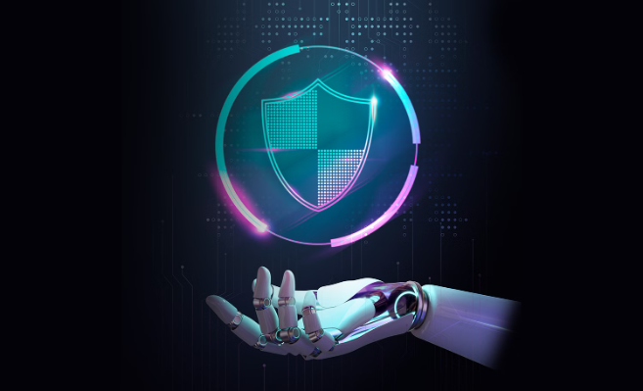
Security and Isolation Measures
Using the Correct Power Supply: An adapter providing the required voltage and current for all components was used.
Using a Box: A box was 3D printed to protect electronic components from water, dust, and impacts.
Water and Moisture Isolation: Teflon tape and insulation tape were used.

Slide 20
Advantages
Remote Monitoring and Control: The status of the water valve and data from the water sensor can be monitored in real-time via the Blynk application. This allows for quick intervention in emergencies such as water leaks.
Flexibility and Customizability: The flexibility and programmability of ESP32 allow the system to be customized as needed. Additional sensors can be easily added.
Ease of Use: The Blynk application has a user-friendly interface, making it easy to use and manage the system.

Slide 21
Reliability and Durability: Jumper cables and connections may not be reliable in the long term and may experience disconnections. More robust connections and wiring solutions may be required.
Disadvantages
Reliability and Durability: Jumper cables and connections may not be reliable in the long term and may experience disconnections. More robust connections and wiring solutions may be required.
Dependency and Security: The system depends on an internet connection and the Blynk platform. If the internet connection is lost or there is an issue with the Blynk service, monitoring and control capabilities may be lost.
Power Consumption: ESP32 and other components require continuous power. It is important to minimize power consumption for long-term use and provide an appropriate power source.
Maintenance and Support: Periodic maintenance of system components may be necessary. Regular checks are important to ensure that water sensors and valves are functioning correctly.

Slide 22
Future Developments
Artificial Intelligence and Machine Learning: By analyzing past water usage data, future water consumption can be predicted, and recommendations for water savings can be made.
Automatic Water Distribution: Integration with smart irrigation systems for automatic watering of plants and green spaces.
Integration with Weather Data: Integration with weather data to prevent watering during rain and optimize water usage.
Voice Assistant Integration: Integration with smart home assistants such as Amazon Alexa or Google Assistant to facilitate control and monitoring.

Slide 23
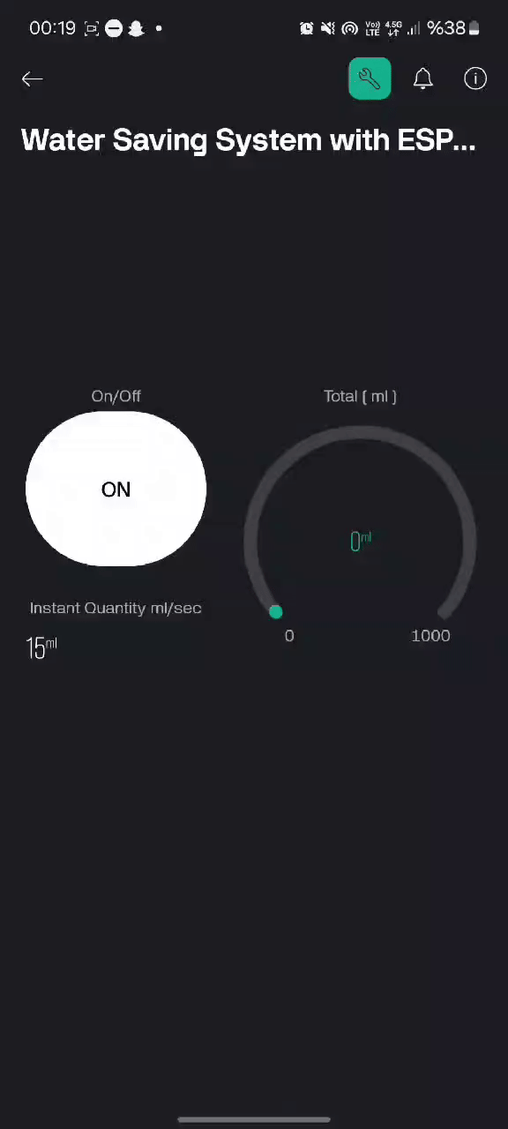
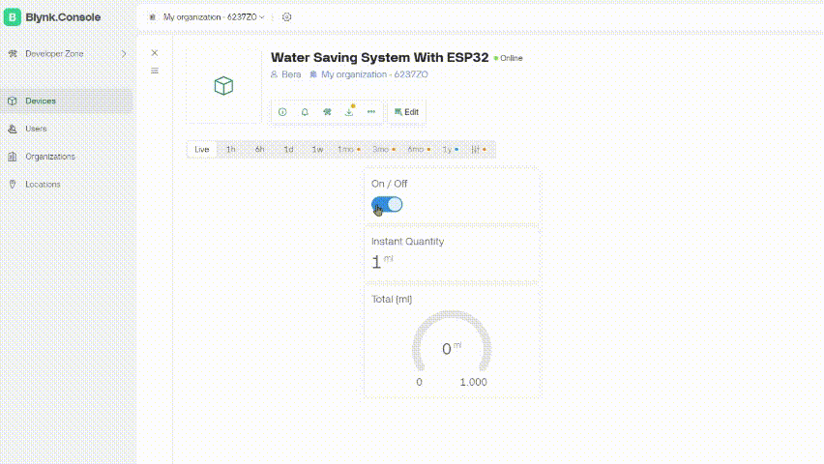
Test video :
Mobil app
Web site

Slide 24
Thank you ! <3

